Slide 1
Week#03
Data Structures
CS2001
Email: rafia.shaikh@nu.edu.pk

Slide 2
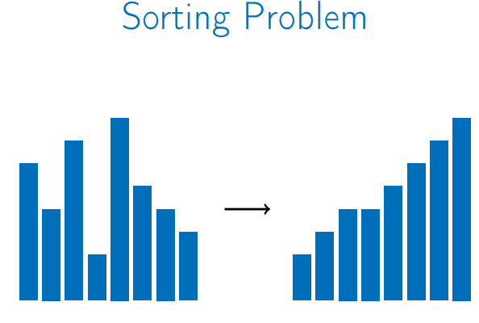
Why sorting?
Sorting data is an important step of many efficient algorithms.
Sorted data allows for more efficient queries.

Slide 3
Elementary Sorting Techniques
The objective of the sorting method is to rearrange the items such that their keys are ordered according to some well-defined ordering rule (usually numerical or alphabetical order).
Insertion Sort
Selection Sort
Bubble sort
Radix Sort
Shell sort
Comb sort

Slide 4
Elementary Sorting Techniques
Simple Algorithms:
Ideal for one-time or infrequent use cases.
Suitable for small datasets (less than a few hundred elements).
Low overhead, faster for small files (less than a few dozen elements).
Time Complexity:
Generally 𝑂(𝑁^2) for sorting N randomly arranged items.
Adequate for small datasets, but not suitable for large, randomly arranged datasets.
Performance Considerations:
Effective for datasets that are nearly sorted or contain many duplicate keys.
May outperform sophisticated algorithms for tiny files or special cases

Slide 5
Elementary Sorting Techniques
Shellsort:
An exception among elementary methods.
More efficient for larger datasets, a preferred method for midsize files.
Application Context:
Use elementary methods for small or special-case datasets.
Consider alternatives like shellsort for larger files.

Slide 6
Bubble Sort
The first sort that many people learn, because it is so simple, is bubble sort: Keep passing through the file, exchanging adjacent elements that are out of order, continuing until the file is sorted.
Bubble sort’s prime virtue is that it is easy to implement, but whether it is actually easier to implement than insertion or selection sort is arguable.
Bubble sort generally will be slower than the other two methods, but we consider it briefly for the sake of completeness.

Slide 7
Bubble sort
Two Approaches to Bubble Sort
Standard Bubble Sort
Moves the largest unsorted element to its correct position at the end of the array in each pass.
Reverse Bubble Sort (Smallest to Top)
Moves the smallest unsorted element to its correct position at the beginning of the array in each pass.

Slide 8
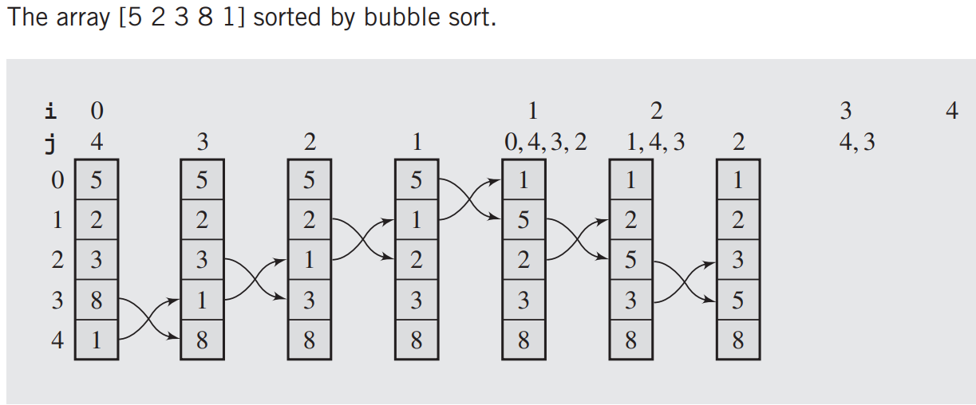

Slide 9
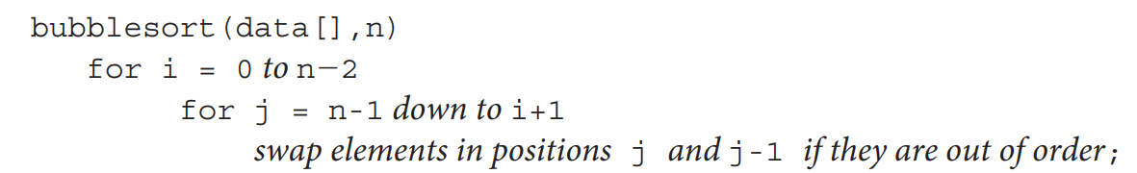
A pseudocode of the algorithm is as follows:

Slide 10
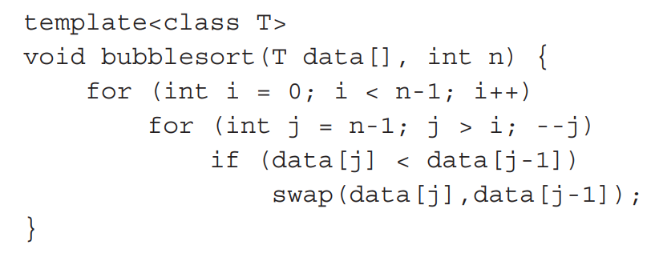
Here is an implementation of bubble sort:

Slide 11
Bubble Sort Characteristics:
Step-by-Step Movement: Bubbles items incrementally toward the top of the array.
Adjacent Comparisons: Compares and swaps two adjacent elements if out of order.
Inefficient Element Movement: If an element needs to move from the bottom to the top, it is swapped with every element in between.
No Skipping: Unlike Selection Sort, Bubble Sort does not skip elements during the process.
Focus on Single Element: Concentrates on the item being bubbled up, ignoring the rest of the array.
Unnecessary Swaps: Moves elements even if they are already in their final positions, leading to inefficiency.

Slide 12
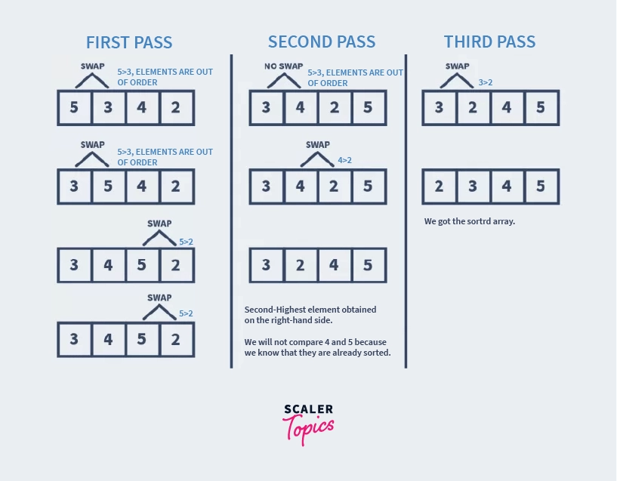

Slide 13
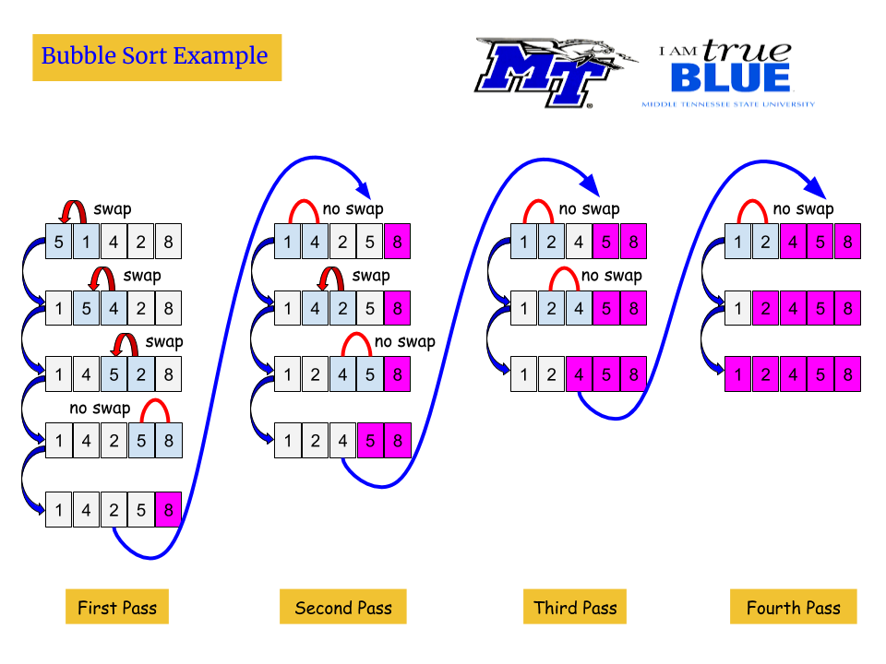

Slide 14
Have a look to this !!
Check out this link for an animation of sorting algorithms; it will give you a clear understanding of the concepts.
https://visualgo.net/en/sorting?slide=1

Slide 15
#include<iostream>
using namespace std;
void bubbleSort(int array[],int aSize);
void printArray(int array[], int aSize);
void mySwap(int &a, int &b);
int main()
{
int list[5] = {5, 1, 4, 2, 8};
cout << "Before sorting: " << endl;
printArray(list,5);
bubbleSort(list,5);
cout << "After sorting: " << endl;
printArray(list,5);
return 0;
}
void bubbleSort(int array[],int aSize)
{
for(int i = 0; i < aSize -1; i++)
{
for(int j = 0; j < aSize-1-i; j++)
if(array[j] > array[j+1])
mySwap(array[j], array[j+1]);
}
}
void printArray(int array[], int aSize)
{
for(int i = 0; i < aSize; i++)
{
cout << array[i]<< " ";
}
cout << endl;
}
void mySwap(int &a, int &b)
{
int temp;
temp = a;
a = b;
b = temp;
}

Slide 16
Optimized Bubble Sort
void bubbleSort(int array[], int aSize) {
bool SwapFlag = false;
for (int i = 0; i < aSize - 1; i++) { // Correct outer loop to avoid unnecessary comparisons
SwapFlag = false; // Reset the flag for each iteration
for (int j = 0; j < aSize - 1 - i; j++) { // Limit inner loop to avoid out-of-bounds access
if (array[j] > array[j + 1]) {
// Swap the elements
int temp = array[j];
array[j] = array[j + 1];
array[j + 1] = temp;
SwapFlag = true;
}
}
// If no swaps were made, the array is sorted
if (!SwapFlag)
break;
}
}

Slide 17
Selection Sort
One of the simplest sorting algorithms works as follows.
First, find the smallest element in the array, and exchange it with the element in the first position.
Then, find the second smallest element and exchange it with the element in the second position.
Continue in this way until the entire array is sorted.
This method is called selection sort because it works by repeatedly selecting the smallest remaining element.

Slide 18






Selection sort: example
Find a minimum by scanning the array.
Swap it with the first element.
Repeat with the remaining part of the array.
Selection Sort - Sorting Algorithm Animations | Toptal®

Slide 19
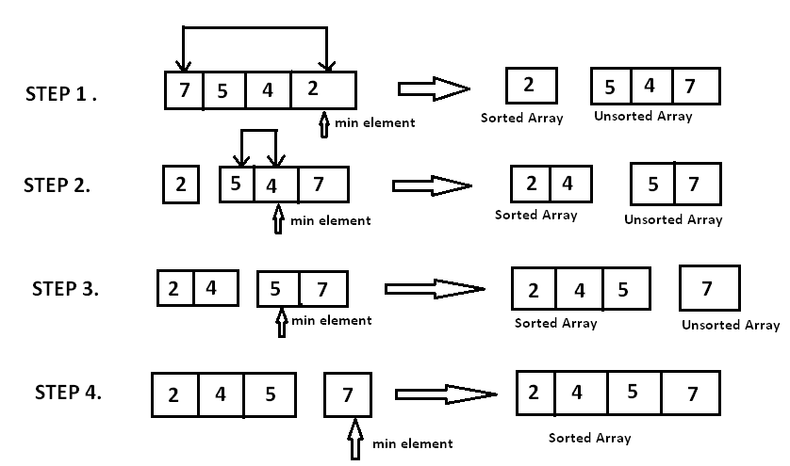

Slide 20
Have a look to this!!
Check out this link for an animation of sorting algorithms; it will give you a clear understanding of the concepts. https://visualgo.net/en/sorting?slide=1

Slide 21
#include<iostream> using namespace std; void selectionSort(int array[],int aSize); void printArray(int array[], int aSize); void mySwap(int &a, int &b); int main() { int list[5] = {5, 1, 4, 2, 8}; cout << "Before sorting: " << endl; printArray(list,5); selectionSort(list,5); cout << "After sorting: " << endl; printArray(list,5); return 0; } | void selectionSort(int array[],int aSize) { for(int i=0; i<aSize-1; i++){ int minIndex=i; for(int j=i+1; j<aSize; j++){ if(array[j]<array[minIndex]) minIndex=j; } //swap if(minIndex!=i) mySwap(array[minIndex], array[i]); } } void mySwap(int &a, int &b) { int temp; temp = a; a = b; b = temp; } | void printArray(int array[], int aSize) { for(int i = 0; i < aSize; i++) { cout << array[i]<< " "; } cout << endl; }

Slide 22
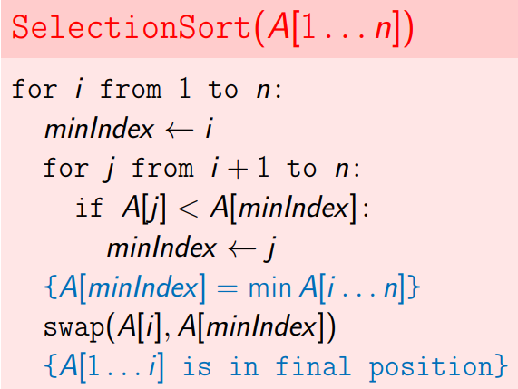
Selection sort algo
TC = O(n^2)

Slide 23
Selection Sort: Summary
Selection sort is an easy to implement algorithm with running time O(n^2 ).
Sorts in place: requires a constant amount of extra memory.
Disadvantage: Running time is similar for sorted, reverse-sorted, or randomly ordered files.
Advantage: Minimizes the number of swaps or data movements.
Application:
Particularly useful when the cost of moving data is high compared to comparison operations.

Slide 24
Tasks
A card trick requires that you put a deck of cards in order by suit (in the order spades, hearts, clubs, diamonds) and by rank within each suit. Ask a few friends to do this task (shuffling in between!) and write down the method(s) that they use.
What is the maximum number of exchanges involving any particular element during selection sort? What is the average number of exchanges involving an element?
Is selection sort stable?

Slide 25
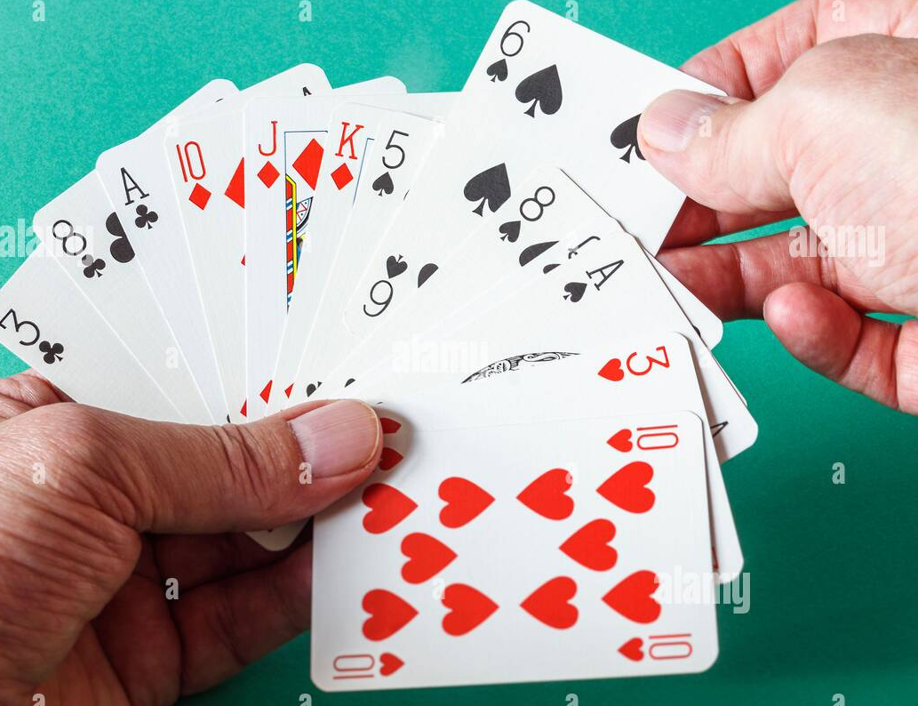
Insertion Sort
The method that people often use to sort bridge hands is to consider the elements one at a time, inserting each into its proper place among those already considered (keeping them sorted).
In a computer implementation, we need to make space for the element being inserted by moving larger elements one position to the right, and then inserting the element into the vacated position

Slide 26
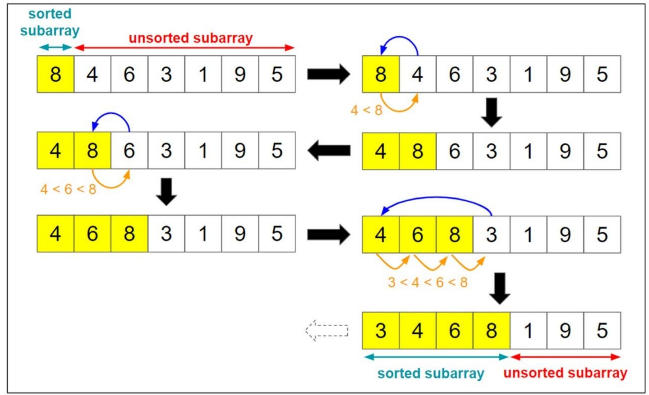

Slide 27
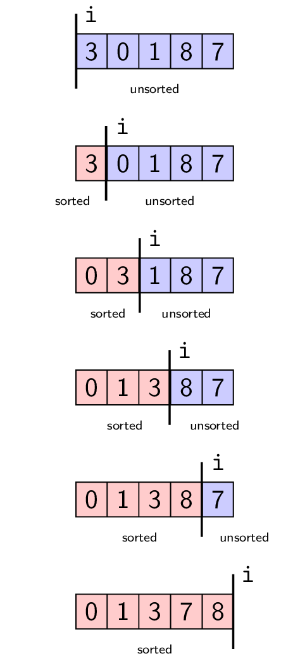

Slide 28
#include <iostream> using namespace std; int main() { // Write C++ code here int list[5] = {5, 1, 4, 2, 8}; cout << "Before sorting: " << endl; printArray(list,5); insertionSort(list,5); cout << "After sorting: " << endl; printArray(list,5); return 0; } | //insertion sort void insertionSort(int array[],int aSize) { for(int i = 1; i < aSize; i++) { int temp=array[i]; int j=i-1; while(j>=0 && array[j]>temp){ array[j+1]=array[j]; j--; } array[j+1]=temp; } } | void printArray(int array[], int aSize) { for(int i = 0; i < aSize; i++) { cout << array[i]<< " "; } cout << endl; }

Slide 29
Have a look to this!!
Check out this link for an animation of sorting algorithms; it will give you a clear understanding of the concepts.
https://visualgo.net/en/sorting?slide=1

Slide 30
Summary
Time complexity: O(n^2)
An advantage of using insertion sort is that it sorts the array only when it is really necessary.
Running Time Dependence:
Depends on Initial Order: The running time of insertion sort is highly influenced by the initial order of the keys.
Efficient for Nearly Sorted Data: Performs quickly if the keys are already in order or nearly in order.
Advantageous for Small or Nearly Sorted Files: Outperforms selection sort when dealing with files that are already sorted or nearly sorted.

Slide 31
Radix Sort
Radix Sort is a linear sorting algorithm that sorts elements by processing them digit by digit. It is an efficient sorting algorithm for integers or strings with fixed-size keys.
For example, processing the full key at every step is often unnecessary: to look up a person’s number in a telephone book, we often just check the first few letters in the name to find the page containing the number

Slide 32
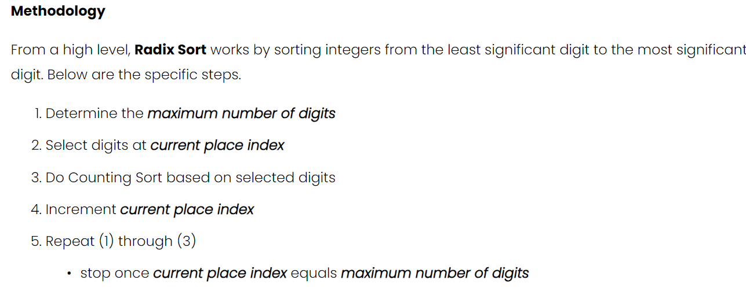
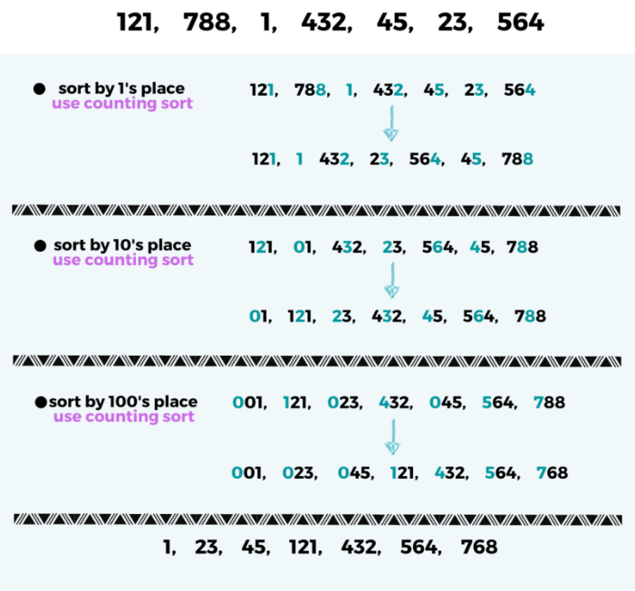

Slide 33
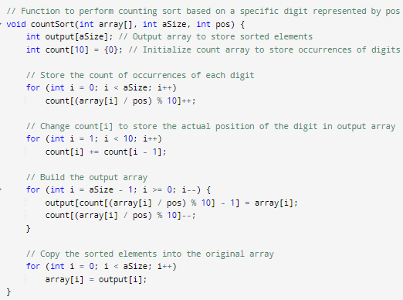
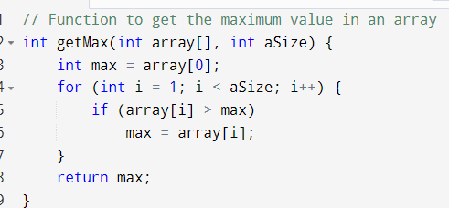
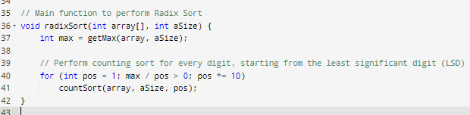

Slide 34
Have a look to this!!
Check out this link for an animation of sorting algorithms; it will give you a clear understanding of the concepts.
https://visualgo.net/en/sorting?slide=1

Slide 35
Shell sort
Insertion sort is slow because the only exchanges it does involve adjacent items, so items can move through the array only one place at a time. For example, if the item with the smallest key happens to be at the end of the array, N steps are needed to get it where it belongs.
Shell sort is a simple extension of insertion sort that gains speed by allowing exchanges of elements that are far apart.

Slide 36
Shell sort
Shell sort is mainly a variation of Insertion Sort. In insertion sort, we move elements only one position ahead. When an element has to be moved far ahead, many movements are involved.
The idea of Shell Sort is to allow the exchange of far items.
In Shell sort, we make the array h-sorted for a large value of h. We keep reducing the value of h until it becomes 1. An array is said to be h-sorted if all sublists of every h’th element are sorted.

Slide 37
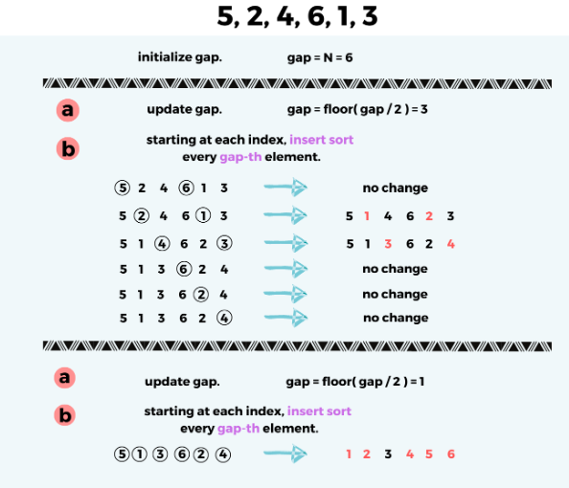
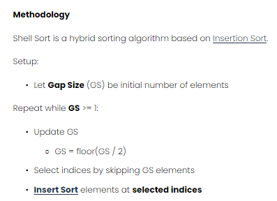

Slide 38
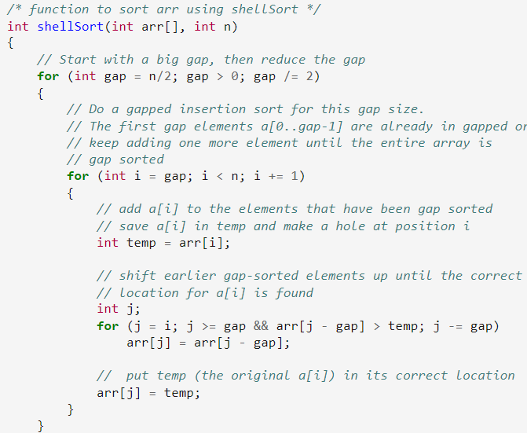

Slide 39
Comb sort
Comb sort is a comparison sorting algorithm improves on Bubble sort. The basic idea is to eliminate turtles, or small values near the end of the list, since in a bubble sort these slow the sorting down tremendously.

Slide 40
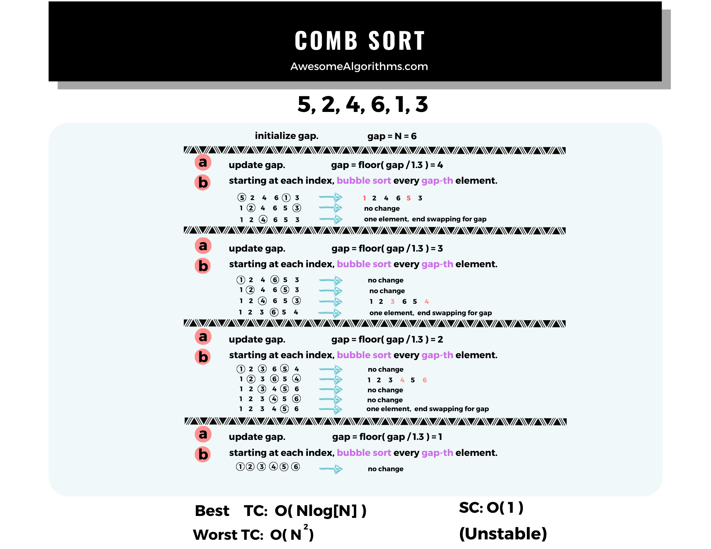
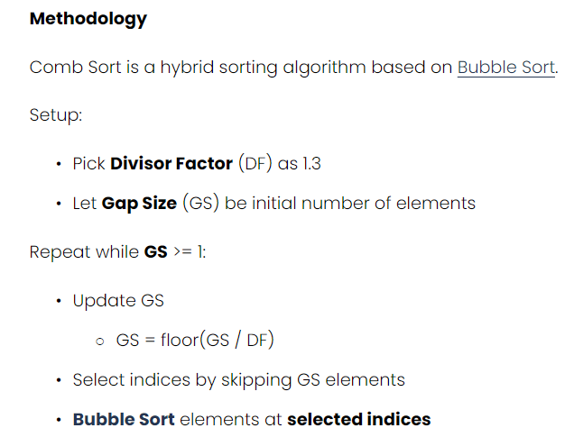

Slide 41
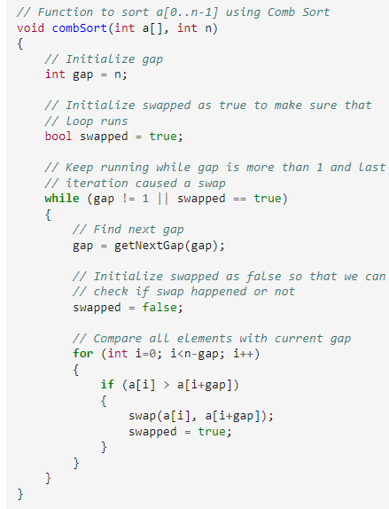
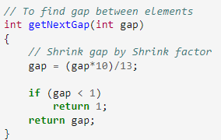

Slide 42
Sorting of Linked Lists

Slide 43
Linked-list
Apply Insertion Sort, Selection Sort, and Bubble Sort to different types of linked lists (singly, doubly, and circular)

Slide 44
Implementation in C++ will be done in the lab

Slide 45
Reference
Chapter#09 Sorting
Book - “Data Structures and Algorithms in C++ by Adam Drozdek”
Chapter#06 of “Robert Sedgewick - Algorithms in C++, Parts 1-4_ Fundamentals, Data Structure, Sorting, Searching, Third Edition-Addison-Wesley Professional (1998)” Book.
Website: geek for geek
Chapter#10 “Radix Sorting” of “Robert Sedgewick - Algorithms in C++, Parts 1-4_ Fundamentals, Data Structure, Sorting, Searching, Third Edition-Addison-Wesley Professional (1998)” Book.

Slide 46

Einstein’s quote is suggesting that true intelligence involves being flexible and open to change.

Slide 47

This means that we are never given more problems than we can handle, so we can trust that we have the strength to get through tough times.

